Slide 1
Educate Before You Integrate Microservices

Slide 2
hello!
I am Yogi Aradhye
Principal Consultant @ Headspring
Blog: https://aradhye.com
You can find me at @yaradhye

Slide 3
Agenda
Background
Typical failures
Principles for Integration
Types of integration
Where to start
Takeaways

Slide 4
1.
What’s a Monolith?

Slide 5
Software whose design, information model, and interface combine multiple competing and interfering domains into one single application and data model.
JBogard

Slide 6
2.
What’s a Service?

Slide 7
A Service should provide a distinct business function, it should be a coarse-grained piece of logic, and autonomous
Arnon rotem-gal-oz (SOA patterns Author)

Slide 8
3.
Drivers for Microservices

Slide 9
4,156,932,140
Number of users active internet users
https://www.internetworldstats.com/stats.htm

Slide 10
4,156,932,140
54.4%
8.3%
That’s a lot of people
World population
North America
https://www.internetworldstats.com/stats.htm

Slide 11
Scale
Fraction of the internet users
Push you to scale

Slide 12
Infrastructure At Scale
Every service has different needs
Scaling everything equally creates a lot of waste

Slide 13
Costs
Scale
Drive the Infrastructure costs

Slide 14
Failure is inevitable. How quickly we can respond to it is more important the complete
Multiple leaders in technology

Slide 15
Autonomy
Responding to failure
Autonomy

Slide 16
Autonomy
Deploy at any time
Choose tech stack that’s a better fit

Slide 17
Drivers for Microservices
Scale
Cost
Autonomy

Slide 18
4.
Example

Slide 19
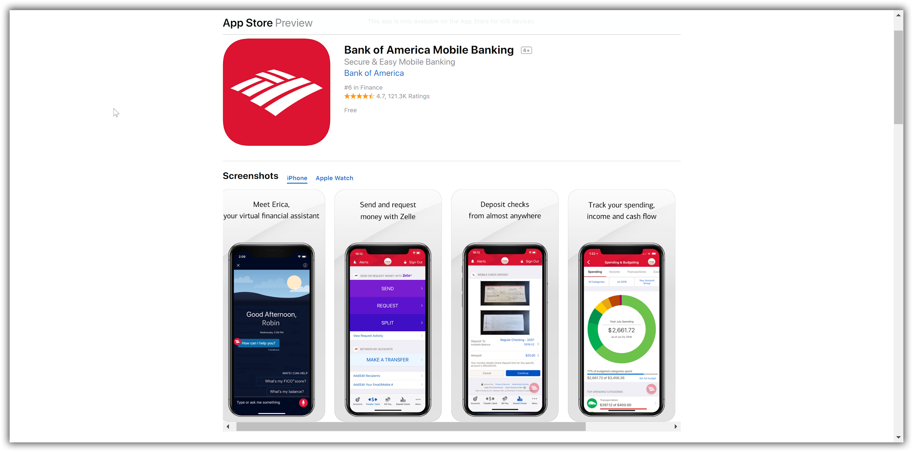
Banking Application

Slide 20
Services
User Profile
Service
Login and Security
service
Transactions
Service
Spending Reports
Service
Credit Score
Service
Notifications
Service

Slide 21
5
Where does it go wrong?

Slide 22
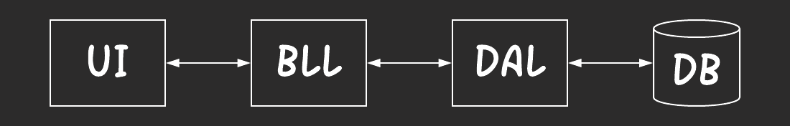
Looks Familiar? Layers

Slide 23
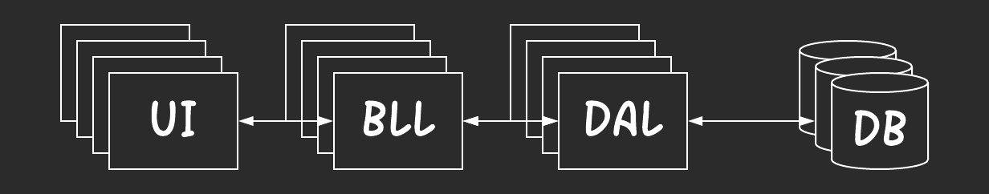
Layers At Scale

Slide 24
Distributed Monolith
Based on technical implementations instead of business boundaries
Requires multiple coordinated deployments
Methods were in the service class, now they are remote procedure calls
There is a lot of network chatter

Slide 25
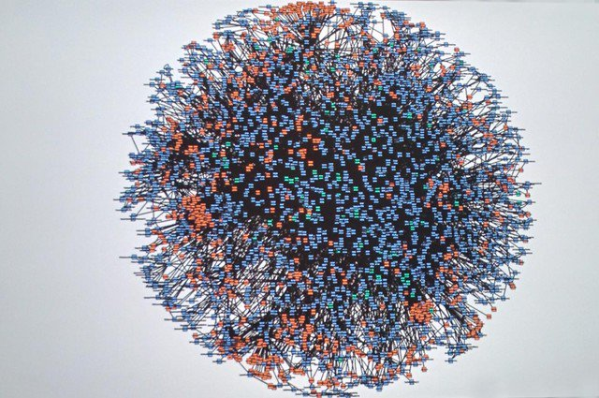
Distributed Monolith - 2

Slide 26
Distributed Monolith - 3
Messaging everywhere..

Slide 27
Distributed Monolith - 3
Just implementing messaging doesn’t mean you don’t have a distributed monolith
CRUD based messaging systems fall into this pit

Slide 28
6.
Principles for Integration

Slide 29
Coupling
Interdependence between modules
The loosely coupled systems share well-defined data
Not dependent on
States
Uptime
Performance levels
Technical implementation details

Slide 30
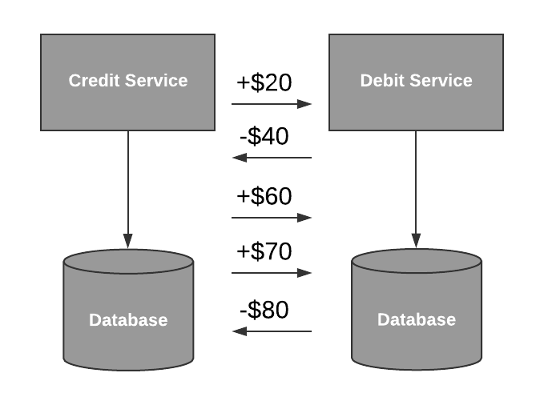
Coupling

Slide 31
What’s my account balance?
It depends
on who you ask
and when you ask 😒

Slide 32
Coupling
Highly coupled and less cohesive

Slide 33
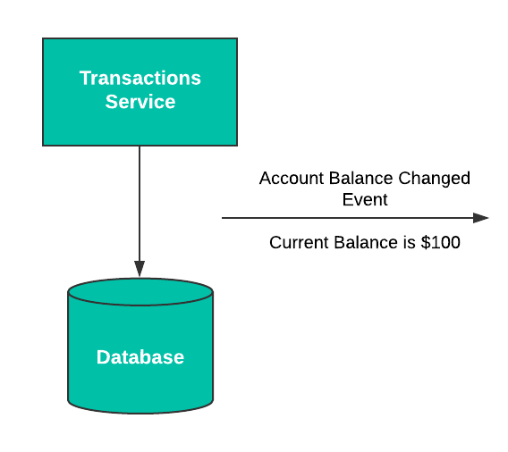
Loosely coupled and highly cohesive

Slide 34
Chatty Services

Slide 35
2. Iterating over Business Boundaries

Slide 36
If something can go wrong, it will

Slide 37
3. Knowing The Fallacies Of Distributed Systems
The network is reliable.
Latency is zero.
Bandwidth is infinite.
The network is secure.
Topology doesn't change.
There is one administrator.
Transport cost is zero.
The network is homogeneous.

Slide 38
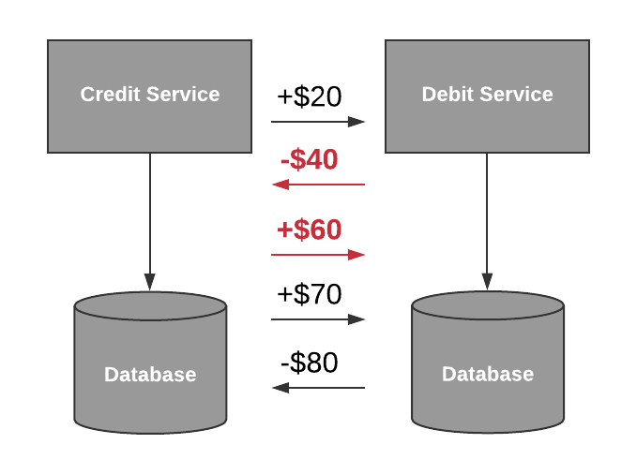
4. BEING CAREFUL WITH SYNCHRONOUS (BLOCKING) API CALLS (RPC)

Slide 39
4. BEING CAREFUL WITH SYNCHRONOUS (BLOCKING) API CALLS
How do we handle the failures?
Where does the cache live?
Synchronous services have higher expectations on response times, making them more challenging to scale and maintain.

Slide 40
5. Having Contract Based Mindset
Understand the entering and exiting data
Hide implementation and domain jargon
Avoid pushing unnecessary dependencies

Slide 41
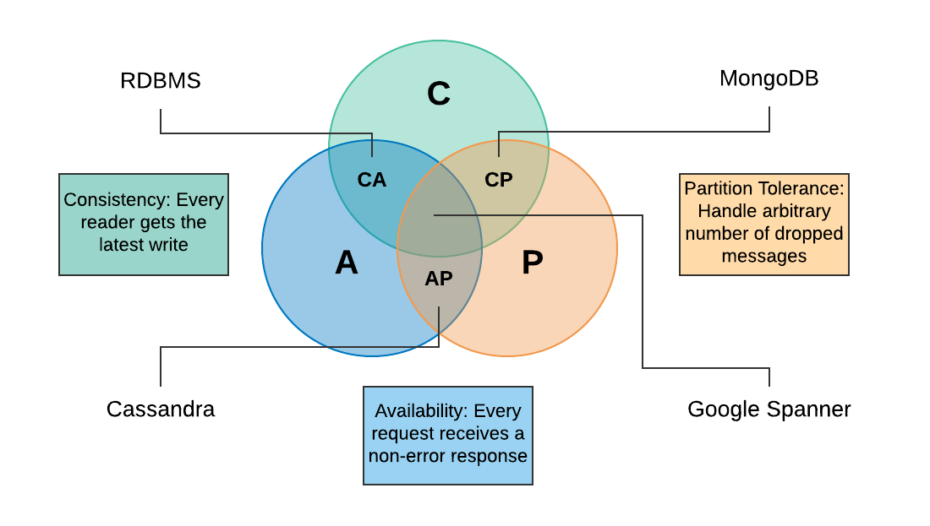
6. Understanding CAP theorem and the Database Technologies

Slide 42
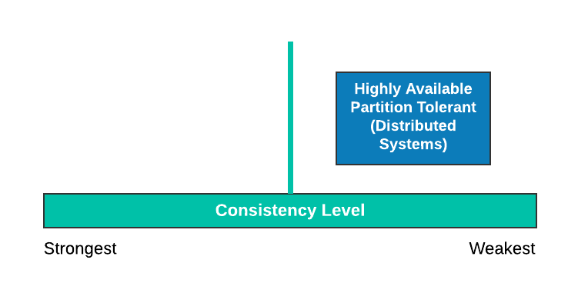
6. Understanding CAP theorem and Database Technologies

Slide 43
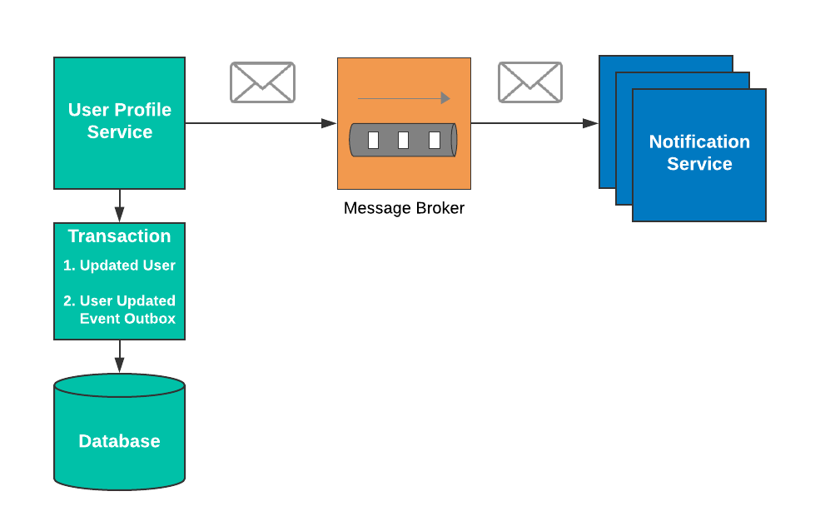
7. Understanding Transactional Boundaries

Slide 44
8. Choreography over Orchestration
Orchestration : Requires high level of coordination
Choreography: Every piece knows it own role to play. They do it when the time is right.

Slide 45
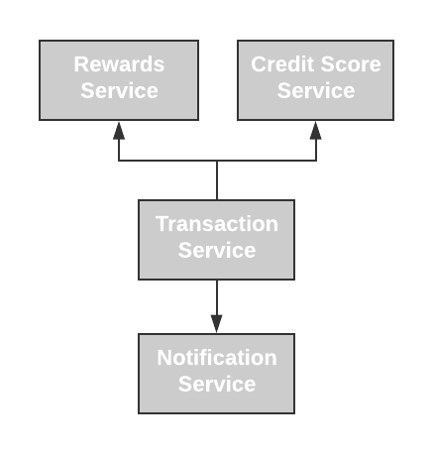
8. Choreography over Orchestration

Slide 46
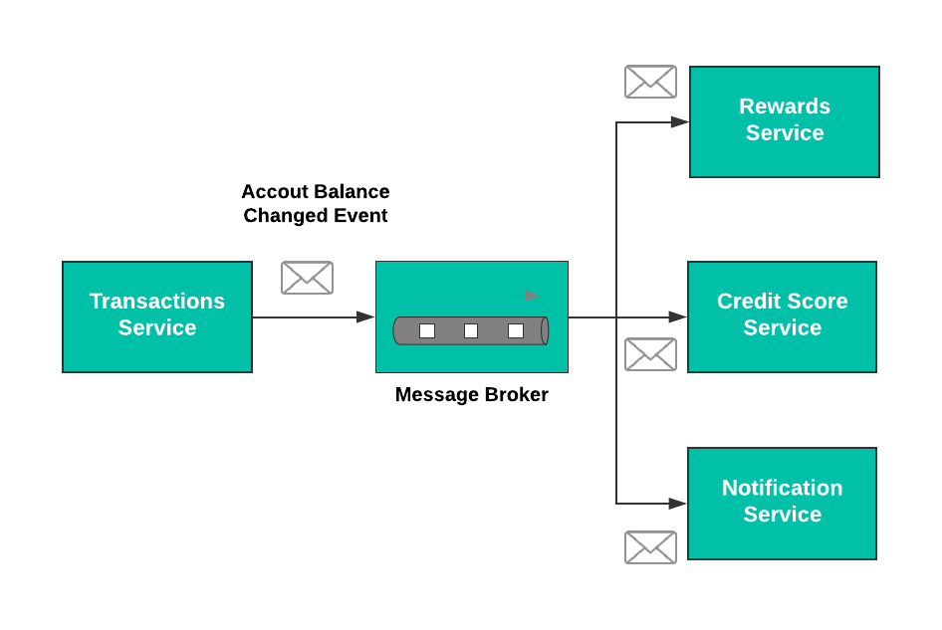
8. Choreography over Orchestration

Slide 47
7.
Types of Integrations

Slide 48
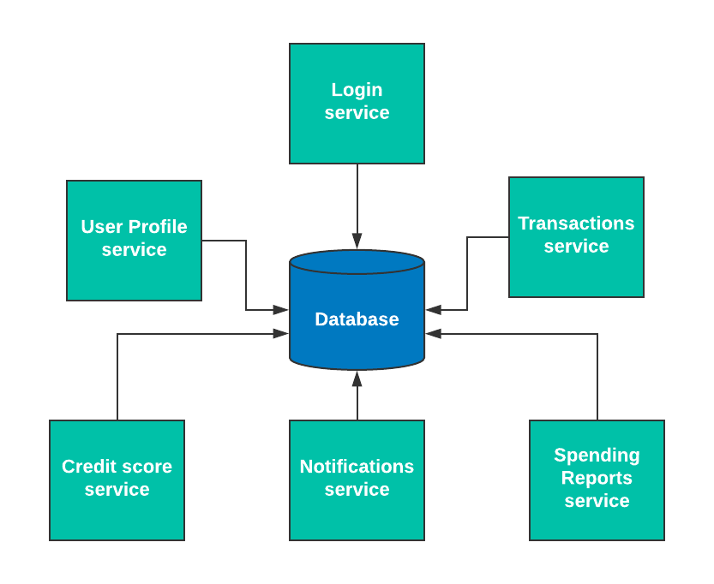
Database Integration

Slide 49
Database Integration
What is it?
Central datastore that all services have access to
Most prevalent form of integration
Pros
Very simple
Fast development turnaround
Easier for transactions and rollbacks
Cons
Introduces very tight coupling
No flexibility from tech
Hard to scale
Wasteful

Slide 50
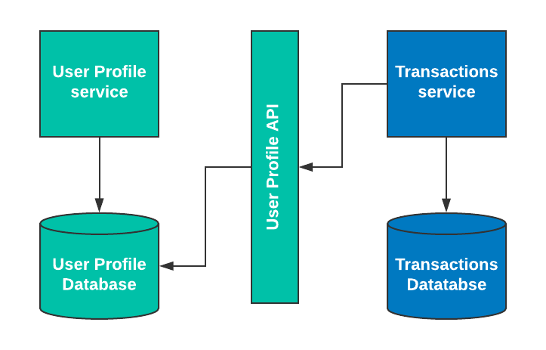
RPC/API calls

Slide 51
RPC/ API calls
What is it?
No direct database access
All calls to the data go through an API
Pull based
Synchronous
Pros
Simple
Fast development turnaround
Hides implementation details
Cons
Keeps the door open for tight coupling
Hard to scale
Caching gets complicated
Necessitates circuit breaking
Rollbacks are tricky

Slide 52
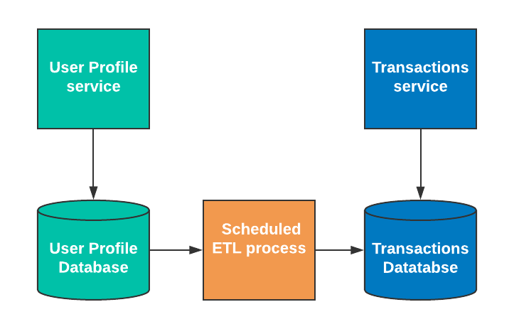
ETL/Data Pumps

Slide 53
ETL/Data Pumps
What is it?
Only backend ETL process needs database access
Pull and Push can be supported
Asynchronous
Pros
Hides implementation details
Caching is pushed to the destination
Tech flexible
Reasonable decoupling
Cons
Changes with the source and destination databases
Data consistency depends on the job schedule
Figuring out the change delta could create challenges
Jobs are usually long running

Slide 54
Messaging with Message Broker Queues

Slide 55
Messaging with Message Queues
What is it?
Integration messages and events are sent via message broker queues such as RabbitMq
No direct database access
Push based
Asynchronous
Pros
Hides implementation details
Caching is pushed to the destination
Tech agnostic
Highest decoupling
Great for live data processing
Cons
Data consistency depends on the broker backlog
Detecting data issues could be challenging
Could be challenging for inexperienced team
Challenging for new services to come to speed

Slide 56
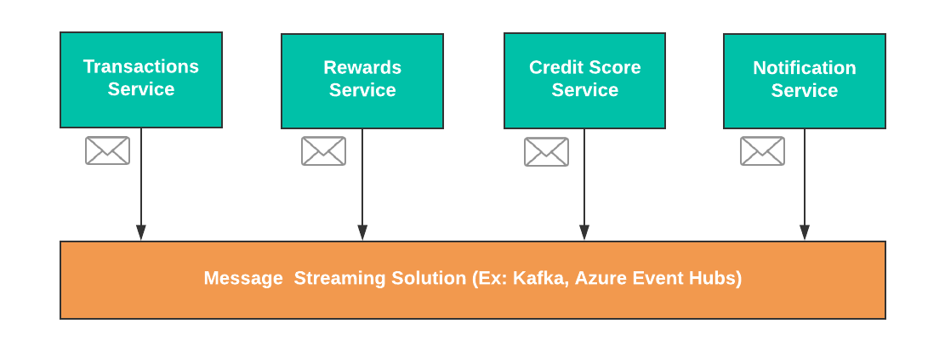
Messaging with Message streaming

Slide 57
Messaging with Message Streaming
What is it?
Integration messages and events are sent via message streaming (Ex: Kafka)
No direct database access
Push based
Asynchronous
Pros
Excellent decoupling
Great for live and historical data processing
Easy recovery from data loss
Cons
Could be challenging for inexperienced team
Storing and archiving streams of data changes may require

Slide 58
8.
Where Do I begin?

Slide 59
Define Success

Slide 60
start working on the business boundaries

Slide 61
Read Vs Writes

Slide 62
Data Ownership

Slide 63
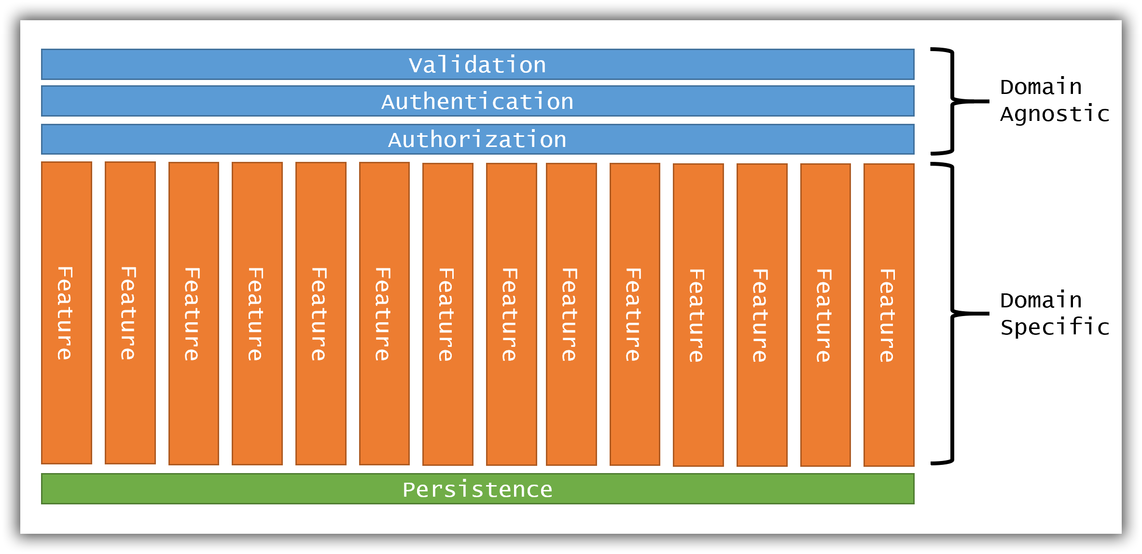
Slices instead of layers
JBogard

Slide 64
Contracts

Slide 65
Plan for Failures

Slide 66
Live user impact

Slide 67

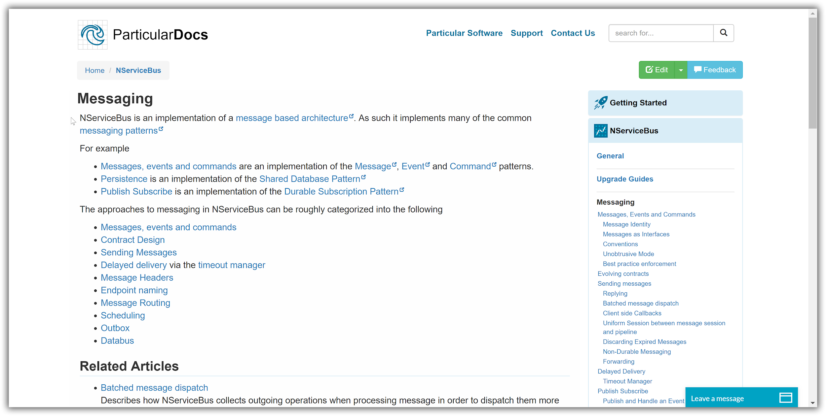
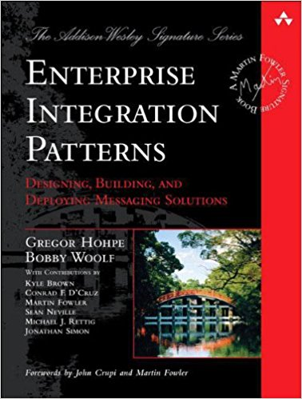
Invest in Messaging
+
=

Slide 68
9.
Takeaway

Slide 69
Takeaway
Start with the domain
Understand your reasons behinds microservices
You may end up with combination of the integration patterns and that is ok
Incorrectly integrated services are not much of an upgrade from having a monolith

Slide 70
thanks!
Any questions?
You can find me at
@yaradhye
Blog: https://aradhye.com

Slide 71
10.
Appendix

Slide 72
Jimmy’s post of Monolith: https://jimmybogard.com/the-false-dichotomy-of-monoliths-and-microservices/
Composite UI: https://www.youtube.com/watch?v=8WrjthKFbTw
Yogi’s blog: https://aradhye.com/tag/microservices/
Slices not layers: https://www.youtube.com/watch?v=wTd-VcJCs_M
Enterprise Integration Patterns Book: https://www.enterpriseintegrationpatterns.com/
SOA Patterns book: https://www.amazon.com/SOA-Patterns-Arnon-Rotem-Gal-Oz/dp/1933988266/ref=sr_1_3?s=books&ie=UTF8&qid=1536508487&sr=1-3&keywords=soa+patterns
This presentation is available at Github: https://github.com/YogirajA/Presentations

